Slide 1
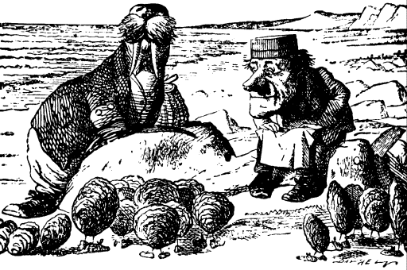
The Teacher and the Researcher

Slide 2
Outstanding…
Brain Gym
Learning Styles
“I know because it’s worked for me”
Faith: Controlling the knowledge

Slide 3
Science is dialectical
It exists in the present, does it destroy the past and pretend it steers us towards a golden age?
Does humanity decides whether something is true or not…?

Slide 4
Science wins
Because of its ubiquitous rhetoric and the faith in ‘progress’, a belief that ‘things can only get better’
Is it sometimes driven by opposition to current truths ?

Slide 5
Research:
There is evidence that in all sciences the strength of evidence for something reduces:
This is called the decline effect.

Slide 6
Research:
Even mice in laboratories being experimented on react differently, nothing is entirely replicable, the mice might react differently because of the smell of the scientist but ‘we’ don’t know!

Slide 7
Research:
How many findings aren’t true or are exaggerated…?
How many ‘little’ studies are any use? Can funding allow big studies?

Slide 8
Research:
Big studies run up against ethical and financial objections.
Discoveries keep arriving and the ‘rhetoric of science’ takes over…
Negative results sometimes ignored?

Slide 9
Research:
We can find plausible patterns in anything…
Who wants this headline:
‘Science Doesn’t Know Anything New’

Slide 10
Research:
Measurement & targets:
Aim: BMI between 20 & 25
Must eat 5 portions fruit and veg & no more than 30 grms of saturated fat per day

Slide 11
Research:
Problem is when it comes down to it nothing valuable or useful can be summed up by a mere number of target.

Slide 12
Research:
E.G:
In a large study from Canada being overweight was associated with living longer.
BMI: 25-30 = overweight but you live longer

Slide 13
Research:
E.G:
Saturated Fat:
Now we can eat butter and cheese
Margarine is bad

Slide 14
Research:
E.G:
Five a day:
Spuds removed so as not to encourage eating of chips.
5+2 needed!
Apparently no benefit from the +2 according to British Medical Journal

Slide 15
Research:
We are all confused!
Do we count calories? Measure BMI? Count Veg? How big is the portion? Eat Potatoes? Be overweight?
Why are we confused?

Slide 16
Research:
Because the fact is researchers aren’t sure! No-one knows what a good diet is or what weight we should be etc.
All they can do is try to get nearer to the truth. This might mean contradicting previous advice.

Slide 17
Research:
We can now drink more booze:
28 units per week for a man
21 units per week for a woman

Slide 18
Research:
Cheese is now good for you!
Sugar is now the devil, the devil that flavours all those low fat products!

Slide 19
Research:
By making everything measurable i.e. what we eat and how healthy we are we have bred anxiety and the need to adjust the precise numbers as new information becomes available

Slide 20
Research:
Are human beings fixed on the data blinded to what else is going on?
The human being as a whole

Slide 21
Research:
By worrying about small targets (backed up by evidence!) You lose a picture of the whole.
You can’t see the wood because you are obsessing about one tree.

Slide 22
Research:
“In practice diet is too complicated for us to be able to micromanage it. Too much is unknown about how the elements of diet interact for us to be able to change the variables to achieve the result we desire”
Julian Bagginni

Slide 23
Research:
What does hold steady is the advice to eat and drink a balanced diet and have moderate exercise outdoors.
Common Sense?

Slide 24
Rhetoric of science:
By the time it gets to the teacher it has become ‘headlines’ that might also distort the evidence…
By the time it gets into the classroom…

Slide 25
What sense?
Keep your reasons secret! Says Nietzsche
Only the Ubermensch can understand the absurdity and doubt?

Slide 26
What sense?
If science born of natural philosophy replaces tradition, faith and belief what sense will we make of our world?
Why educate in this rational world?

Slide 27
The best teaching
Might occur when you aren’t thinking about what you are doing
The unconscious teaching rooted in experience and tradition might be the most effective…
Question both, what is left?

Slide 28
Galileo by Brecht
Truth held by the Pope, in Latin…
Common people kept from truth in order to keep order and give them hope… hope so that they might strive…

Slide 29
Dilemma?
Backward, docile, teachers accepting diktats…?
Or…
Rational minded teachers accepting the universality of reason but likely to become prevaricating upstarts ready to undermine their leaders?

Slide 30
Educational Enlightenment
Tradition becomes questioned and everything is up for grabs
The ‘common teacher’ grasps the enormity of ideas
Everything is a possible myth…

Slide 31
Once reason is let rip:
It becomes unreasonable…
Faith and custom is where power resides… Not in reason…
But love also exists not in reason but in faith

Slide 32
Once reason is let rip:
Reason becomes a matter of calculation and data it divests itself of values
Values divorced from facts: anti-ideology… Robots rule, cold, rational, logical…

Slide 33
Once reason is let rip:
The terror…?
A school based on reason would cease to motivate…
All become functionaries in a data chase?

Slide 34
We are caught between:
“The smiling lunacies of the man of reason
And
The sodden effusions of the man of feeling” Seamus Deane

Slide 35
Where lies truth?
If I had to live my life again, I would have made a rule to read some poetry & listen to some music at least once every week; for perhaps the parts of my brain now atrophied would thus have been kept active through use. The loss of these tastes is a loss of happiness, & may possibly be injurious to the intellect, & more probably to the moral character, by enfeebling the emotional part of our nature Charles Darwin

Slide 36
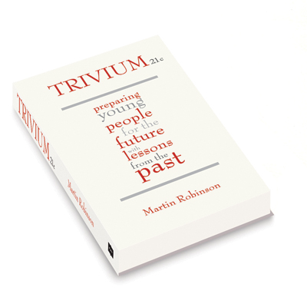
Martin Robinson
Author: Trivium 21c
Twitter: @SurrealAnarchy
Facebook: Trivium21c
Website: martinrobinson.net

